Slide 1

Deep Learning Model For Detecting Diseases In
Tea Leaves
Batch-14
Team members
1.VIJAYANDIRAN S (411720205035)
2.MANI KANDAN M (411720205017)
Guided by
Mrs B. Latha, M.Tech.,
Associate Professor

Slide 2

Objective of the Project
The objective is to deploy an advanced image recognition model that analyzes tea leaf diseases based on color, spots, and textures. The system aims to deliver rapid results through a user-friendly interface. Rigorously tested for precision, the system is designed to connect farmers with experts, providing personalized disease management advice and revolutionizing tea plant health maintenance.

Slide 3
Scope of the Project
Incorporating the VGG16 deep learning model within a Python Flask framework, our web-based tea leaf disease analysis project utilizes advanced image recognition for accurate diagnosis. The user-friendly web interface ensures farmers receive rapid results and promotes expert engagement, empowering them in the effective and sustainable maintenance of tea plant health.

Slide 4
Abstract
Leveraging advanced image recognition, our web-based tea leaf disease analysis system delivers swift and precise results through an intuitive interface. This platform facilitates remote collaboration, connecting farmers with expert advice for personalized disease management, thereby promoting sustainable tea farming practices.

Slide 5
Literature Survey – paper 1
AUTHOR | PAPER TITLE | DESCRIPTION | PUBLICATION
S. P. Raja , Barbara Sawicka et al., | Crop Prediction Based on Characteristics of the Agricultural Environment Using Various Feature Selection Techniques and Classifiers | This study focuses on utilizing machine learning for crop yield prediction, emphasizing the significance of optimal feature selection to enhance model accuracy, reduce redundancies, and demonstrate that ensemble techniques outperform existing classification methods. | IEEE (Institute of Electrical and Electronics Engineers)

Slide 6
Literature Survey – paper 2
AUTHOR | PAPER TITLE | DESCRIPTION | PUBLICATION
Md. Fahad Jubayer et al., | Tea leaf disease detection and identification based on YOLOv7 (YOLO-T)”, Tea leaf disease detection YOLOv7 (YOLO-T) | AI-driven tea leaf disease detection system using YOLOv7, achieving 97.3% accuracy and offering a rapid solution for identifying and managing diseases in the tea industry. | Scientific reports

Slide 7
Literature Survey – paper 3
AUTHOR | PAPER TITLE | DESCRIPTION | PUBLICATION
Jianping Yao, Son N. Tran et al., | Machine learning for leaf disease classification | This study explores the impact of machine learning applications on leaf disease classification in agriculture, providing a comprehensive overview of datasets, techniques, and applications for researchers, engineers, and managers in the field. | Springer Link

Slide 8
Literature Survey – paper 4
AUTHOR | PAPER TITLE | DESCRIPTION | PUBLICATION
Rahul Singh et al., | Proposed CNN Model for Tea Leaf Disease Classification | This research introduces a 73% accurate deep convolutional neural network for rapid and precise classification of tea leaf diseases, surpassing manual methods and extending its diagnostic applications to various plant leaves. | IEEE (Institute of Electrical and Electronics Engineers)

Slide 9
Literature Survey – paper 5
AUTHOR | PAPER TITLE | DESCRIPTION | PUBLICATION
S. Jayanthy et al., | Tea Leaf Disease Classification and Tea Bud Identification | This study in Tamil Nadu implements deep learning and machine learning (CNN and SVM) to detect diseases in tea leaves and classify tea buds, achieving high accuracies of 96.703% and 96.923%, respectively, with a real-time dataset and augmentation. | IEEE (Institute of Electrical and Electronics Engineers)

Slide 10
Literature Survey – paper 6
AUTHOR | PAPER TITLE | DESCRIPTION | PUBLICATION
Manasa J P et al., | MOBILE BASED APPLICATION FOR TEA LEAF DISEASE DETECTION | This ML-powered mobile-based system utilizes CNN for early detection and classification of tea leaf diseases, providing a user-friendly interface for farmers to capture and diagnose plant issues, enhancing crop health management. | IEEE (Institute of Electrical and Electronics Engineers)

Slide 11
Literature Survey – paper 7
AUTHOR | PAPER TITLE | DESCRIPTION | PUBLICATION
Vishesh Tanwar et al., | Tea Leaf Diseases Classification and Detection using a Convolutional Neural Network | In India, machine learning, specifically Convolutional Neural Networks, attains a 96% accuracy in early detection and classification of tea leaf diseases, crucial for sustaining agricultural practices. | IEEE (Institute of Electrical and Electronics Engineers)

Slide 12
EXISTING SYSTEM
Plant Village is a web application uses deep learning for tea leaf disease detection with a farmer-friendly interface for image uploads.
Leaf Doctor is a mobile app employing deep learning to identify plant diseases, including those in tea leaves, through smartphone images.
Tea leaf disease detection faces feasibility challenges for small-scale industries and farmers due to the high costs associated with existing applications and websites, predominantly driven by private sector solutions..

Slide 13
DRAWBACKS
Limited datasets impede the effectiveness of machine learning models for tea leaf disease detection in real-world scenarios, while the absence of remedies for classified diseases hinders timely intervention for plant health.
Challenges in image capturing techniques contribute to poor data quality, reducing the precision of disease identification. Additionally, performance delays in disease detection systems pose a critical challenge, potentially leading to increased crop damage and reduced yields.

Slide 14
PROBLEM STATEMENT
The current manual diagnosis of tea leaf diseases is both time-consuming and subjective, further exacerbated by the impracticality and costliness of expert visits to inaccessible rugged tea gardens. Economic losses and reduced tea production, up to 20%, result from diseases such as TALS, TBB, TWS, and TLB, with disease identification relying on farmers' individual experiences adding a layer of subjectivity to the process.

Slide 15
PROPOSED SYSTEM
The development of an automated Deep Learning Model for tea leaf disease detection utilizes color, spots, and texture characteristics, ensuring accurate disease identification and contributing to improved efficiency, objectivity, and timeliness in disease detection.
The user-friendly interface enables farmers and experts to easily capture tea leaf images, fostering increased tea production and quality through the enhanced capabilities of the automated system.

Slide 16
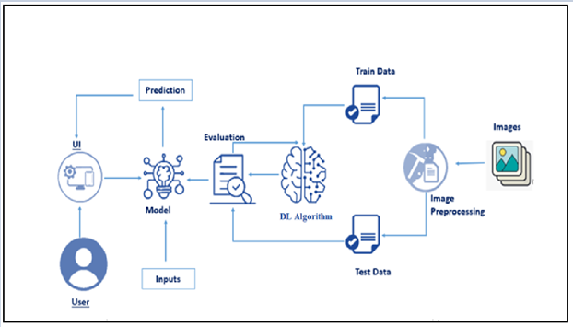
Block diagram

Slide 17
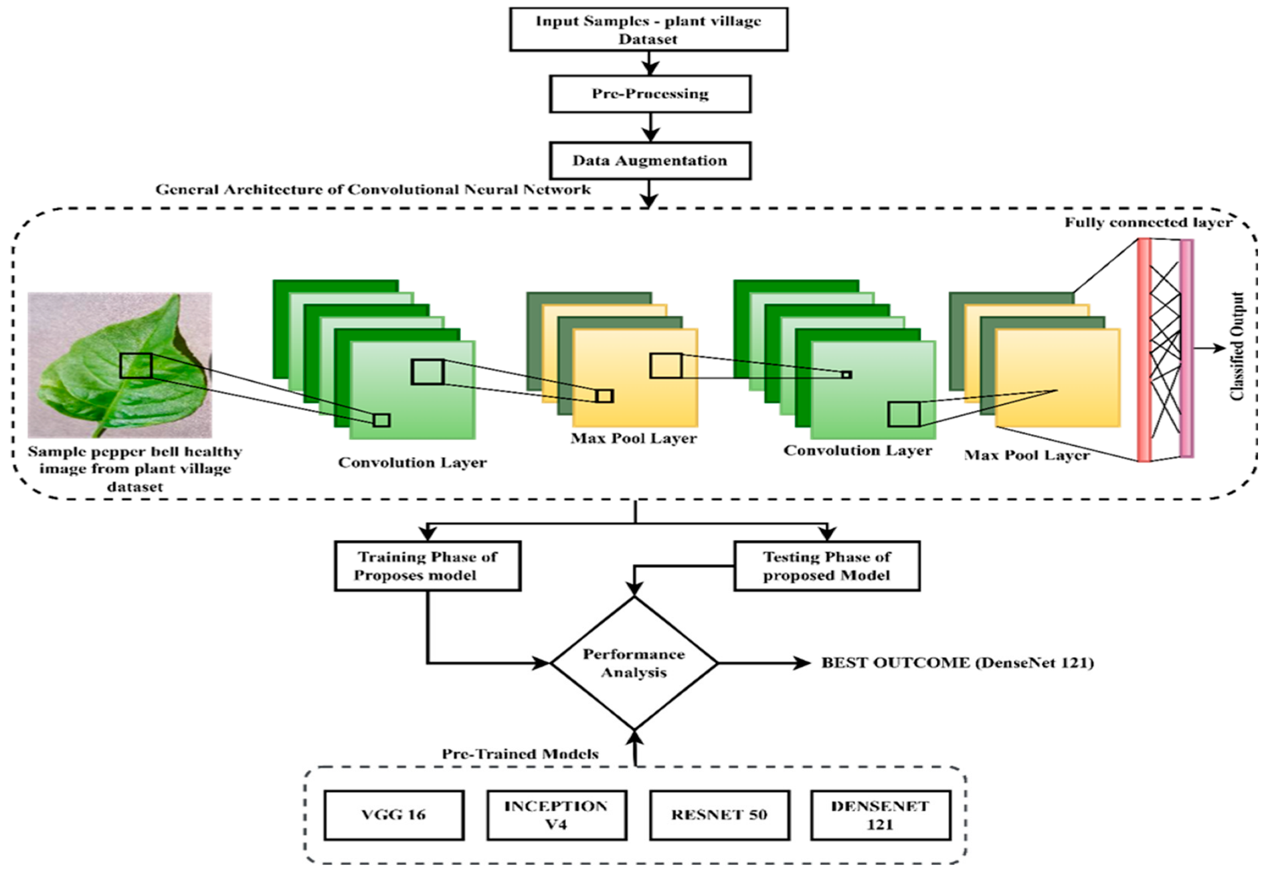
System Architecture

Slide 18
Methodology / Technology
The implementation of a Convolutional Neural Network (CNN) for tea leaf disease pattern recognition applies deep learning principles to enhance model adaptability and accuracy, ensuring robust performance in disease detection.
The user-friendly interface, facilitated by Python Flask and integrated with HTML, CSS, and JavaScript, allows for seamless interaction while continuous data analysis is employed for refining and improving the accuracy of the disease detection model, ensuring dynamic features and structured presentation in the front-end.

Slide 19
Software used
Python employed for backend development in the tea leaf disease detection system.
Flask utilized to create a user-friendly interface for seamless interaction.
Implementation of deep learning libraries, specifically TensorFlow, for the Convolutional Neural Network (CNN).
Integration of image processing tools, including OpenCV, to enhance image analysis capabilities.
Structuring the user interface through HTML and CSS, ensuring an organized and visually appealing design.

Slide 20
Conclusion
Finally, our integrated software stack, featuring Python, Flask, TensorFlow, OpenCV, HTML, CSS, and Pandas, delivers an efficient and user-friendly solution for tea leaf disease detection. This approach, incorporating deep learning and image processing, ensures a precise Convolutional Neural Network implementation, revolutionizing efficiency and accessibility in agricultural practices.

Slide 21
References
[1] JS. P. Raja , Barbara Sawicka et al., “ Crop Prediction Based on Characteristics of the Agricultural Environment Using Various Feature
Selection Techniques and Classifiers” (IEEE).
[2] Jianping Yao, Son N. Tran et al., “Machine learning for leaf disease classification”, Springler, 2023.
[3] Md. Fahad Jubayer et al., “ Tea leaf disease detection and identification based on YOLOv7 (YOLO-T)”, Tea leaf disease detection YOLOv7 (YOLO-T)”
[4] S. Jayanthy et al., “Tea Leaf Disease Classification and Tea Bud Identification”
[5] Rahul Singh et al., “Proposed CNN Model for Tea Leaf Disease Classification”
[6] J P Manasa et al., “Mobile Based Application For Tea Leaf Disease Detection”
[7] Vishesh Tanwar et al., “Tea Leaf Diseases Classification and Detection using a Convolutional Neural Network”

Slide 22
THANK YOU

